Slide 1



Slide 2
" In The Name of Allah, The Most Beneficent, The Most Merciful"
An overview on international Halal Standards
By: Dr. Hani M. Al-Mazeedi

Slide 3
Scope:
This presentation has the objective of introducing international Halal standards.
Standards in general are requirements that aim to provide minimum levels of criteria like quality and safety in products or services.
This philosophy of standards put International Halal Standards in a debatable manner.

Slide 4
This presentation also shed the light on the value of being Halal accredited from an international accreditation organization such as:
    GSO (of the GCC, Gulf Corporative Countries)
    ESMA (of UAE)
    SMIIC (of OIC)
    JAKIM and HDC (of Malaysia)
    MOI (of Indonesia)
Being Halal accredited will facilitate the activities of Halal Certification Bodies in servicing the Halal industry worldwide.

Slide 5
Content
Introduction
Example of international HALAL standards
Requirements of GSO-GAC for Halal Laboratory
Summary
Conclusions
Recommendations

Slide 6
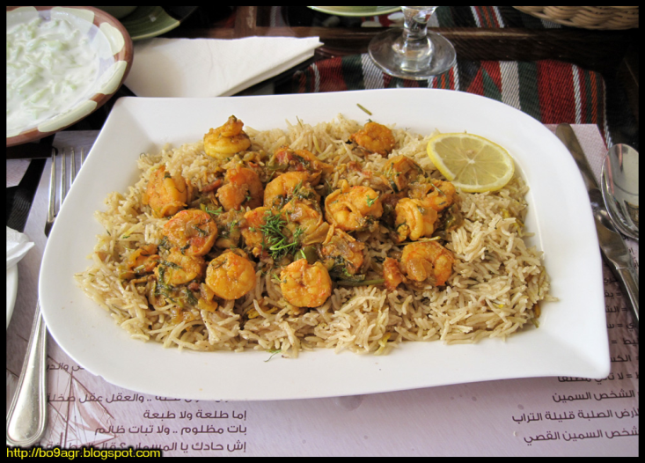
Introduction
The principle for a Muslim’s food and non-food products has to be :
Halal (permissible – Shariah compliant) , and
Quality (wholesome: healthy, safe, nutritious, Tayeb ).

Slide 7
Shariah Law means Islamic Law based on the ¹Quran, ²Hadith (Sunnah), ³Ijma’ and ⁴Qiyas
A particular food or consumer products become Halal or Haram by Shariah Law if it is considered so through by any one of the above mentioned sources or Fatwa (religious edicts) issued by a competent Islamic Authority.

Slide 8
All processes involved in the Halal supply chain (farm to use) must adhere to Shariah laws and verified by a competent Halal certification body.
The objective of the Halal certification is to authenticate¹ and assure² the component factors utilized in the food and non-food industry are all Halal compliant., i.e.
It confirms that the ingredients used in a product are Halal certified¹ and the premise² is free from haram or non-Halal products (authenticity) which can only be confirmed by Lab analysis.

Slide 9
International standards
International standards are standards developed by international standards organizations.
International standards are available for consideration and use worldwide.
The most prominent organization is the International Organization for Standardization (ISO).

Slide 10
International standards cover a wide range of food and non-food items
• Agricultural produce
• Animal Feed
• Beverages
• Chemicals, Flavors & Industrial
• Health & Beauty
• Ingredients & Seasoning
• Fats & Oil Products
• Machinery & Equipment
• Meals & Livestock
• Packaging & Containers
• Prepared Food
• Processed Food
• Pharmaceuticals
• Toiletries & Cosmetics
• Raw Materials & Ingredients
• Rice & Noodles
• Snacks & Confectionary
Nutraceutical
Organic & Herbal Food
• Other Related Products

Slide 11
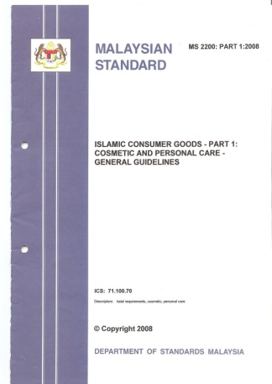
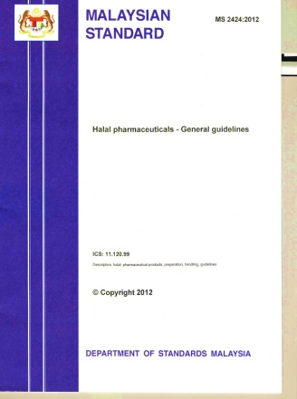
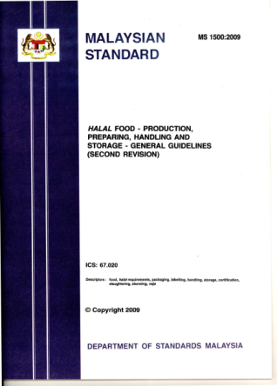
International Halal standards
International Halal standards are Halal oriented standards developed by international standards organizations.

Slide 12

Example of international Halal standards
STANDARDIZATION ORGANIZATION FOR G.C.C (GSO) GSO
993 / 1998
ANIMAL SLAUGHTERING REQUIREMENTS ACCORDING TO ISLAMIC LAW
GSO HALAL standards
GSO 993 / 1998 ANIMAL SLAUGHTERING REQUIREMENTS ACCORDING TO ISLAMIC LAW
Halal food general requirements GSO-Halal_food_part 1-2008
FAD 04 = Supplementary accreditation requirements for Product certification Bodies
FAD* 12 Requirements for Halal Certification Bodies
*FAD = Filed Application Document

Slide 13
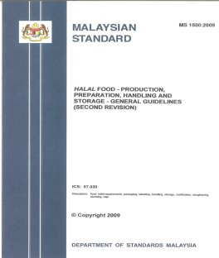
Example of international Halal standards
Malaysian HALAL standards
MS 1500:2009 Halal Food
MS 2200:2008 Halal Cosmetic & Personal Care
MS 1900:2005 Quality Management
MS 2300:2009 Value-Based Management System
MS 2400:2010 Logistic – Transportation
MS 2400:2010 Logistic – Warehousing
MS 2400:2010 Logistic - Retailing

Slide 14

Example of international Halal standards
Thailand HALAL standards
THS 1435-1-2557 Requirements for inspection of manufacturing process of Halal products B.E. 2554
THS 1435-2-2557 Requirements for Halal certification on abattoir and animal dissection B.E. 2554
THS 1435-3-2557 Halal manual
TH 1435-4-2557 Guideline for Halal certificate application on products and packaging
THS 1435-5-2557 Regarding the operation of Halal certification of factory, products, and fee of B.E. 2552

Slide 15


Example of international Halal standards
Brunei HALAL standard
Brunei Darussalam Standard For Halal Food
Philippine HALAL standard
Halal Food – Production, Preparation, Handling and Storage – General Guidelines PNS 2067: 2007

Slide 16
Negative aspects of the current international Halal standards
All Halal standards are similar in their general requirements in promoting Halal and avoiding Haram.
However, if read carefully they are too loose with Halal as prescribed by Quran and Sunnah especially with the requirements that touch certain economical issues which mainly serve the interest of the western industries more than Allah’s demands that ultimately serve the interest of Muslim consumer such as:

Slide 17
Stunning of animal before or after slaughter (allowed if necessary)
Allowing the presence or the use of Najis (religiously prohibited ingredients) due to controversial religious edicts (Fatwas فتاوى) based on the concept of conformation (Istihala)
Allowing the use of Alcohol (synthetic) for manufacturing certain ingredients (How can one be sure it is synthetic as chemically they are all the same ; Ethanol, causes drunkenness, and both are toxics)
Allowing the trade of product that resemble Haram products , e.g., alcohol-free beer and lately alcohol-free whiskey drinks
These are the drawbacks of approved international Halal standards

Slide 18
Due to controversial religious edicts on Halal issues, Islamic countries were forced to:
¹take religious edicts with least constraints
²in some cases, totally not enforcing the Halal standard for the sake of making life easy to their Muslim and non-Muslim consumers, and
³these countries want to show the western world that trade with their countries is with least barriers

Slide 19


Positive aspects of international HALAL standards
Techno-economical-studies often showed positive relationship between application of international standards and trade (imports/exports).
2020
2016
*Dagangnet is the ICT

Slide 20


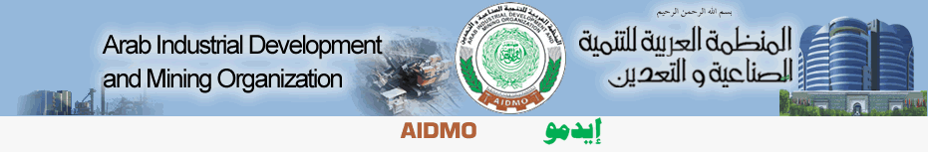




Example of Worldwide Standard Organizations

Slide 21
GSO (Gulf Standard Organization)
GSO
United Arab Emirates
Bahrain
Qatar
Saudi Arabia
Kuwait
Yemen

Slide 22
Main users of standards
Exporting Enterprises
Regulators
i.e. governmental authorities
Labs
NSB
(National Standards Body)
Manufacturer/ trader
Consumer Protection Agencies
Certification Bodies
R & D

Slide 23
Challenges faced by enterprises
Challenge 1
Technical requirements in importing countries difficult to obtain and not well understood
Challenge 2
Enterprises not able to meet standards, technical regulations and SPS* measures
Exporters unable to demonstrate compliance with requirements in importing countries at reasonable cost
Challenge 3
Challenge 4
Inadequate Quality Infrastructure for exports
Inadequate SPS infrastructure hampering market access for food and agricultural products
*An agreement on how governments can apply food safety and animal and plant health measures (sanitary and phytosanitary or SPS measures) sets out the basic rules in the WTO.

Slide 24
Why do we need to certify?
The overall aim of certifying ¹products, ²processes or ³services (e.g. lab analyses) is to give confidence to all interested parties that a ¹product, ²process or ³service fulfills specified requirements.
The value of certification is the degree of confidence and trust that is established by an impartial¹ and competent² demonstration of fulfillment of specified requirements by a third party (i.e. Auditor).

Slide 25
Conclusion
International Halal standards in their general requirements have the claim of protecting Muslim consumers, however, if read carefully one will find in these standards requirements that mainly aim to protect the interest of western trade and industry of food and non-food items among Muslim consumers under the umbrella of Halal.

Slide 26
Getting accredited as a Halal services provider from an internationally approved Halal accreditation body will open doors for Halal activities.
To go beyond the expectation of Muslim consumer one should provide strict Halal (i.e. 5F-Halal).

Slide 27
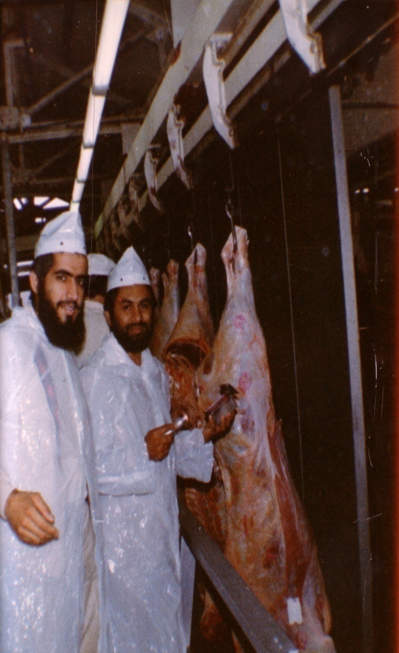
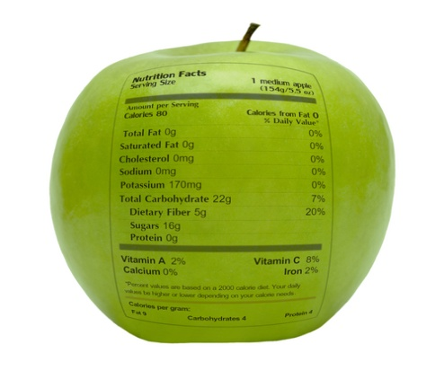
شكراً لاستماعكم
سبحنك اللهم وبحمدك أشهد أن لا إله إلا أنت، أستغفرك وأتوب إليك
د. هاني منصور المزيدي
مع الأخ أمجد محبوب في أستراليا سنة 1981
Dr. Hani Mansour Al-Mazeedi
With brother Amjad Mahboob in Australia in 1981

Slide 28

www.HalalEA.com
Trademarks, icons, images belong to their respective owners.
© Halal Sciences Academy Limited

